Slide 1
Practical & Ethical Guidelines for Texting with Clients
Stephen Ross Johnson
Ritchie, Dillard, Davies & Johnson
Sandy Garrett, Chief Disciplinary Counsel
Board of Professional Responsibility
October 25, 2019

Slide 2
RULE 1.4:
COMMUNICATION
(a) A lawyer shall:
promptly inform the client of any decision or circumstance with respect to which the client's informed consent, as defined in RPC 1.0(e), is required by these Rules;
(2) reasonably consult with the client about the means by which the client's objectives are to be accomplished;
(3) keep the client reasonably informed about the status of the matter;
(4) promptly comply with reasonable requests for information; and
(5) consult with the client about any relevant limitation on the lawyer's conduct when the lawyer knows that the client expects assistance not permitted by the Rules of Professional Conduct or other law.
(b) A lawyer shall explain a matter to the extent reasonably necessary to permit the client to make informed decisions regarding the representation.

Slide 3
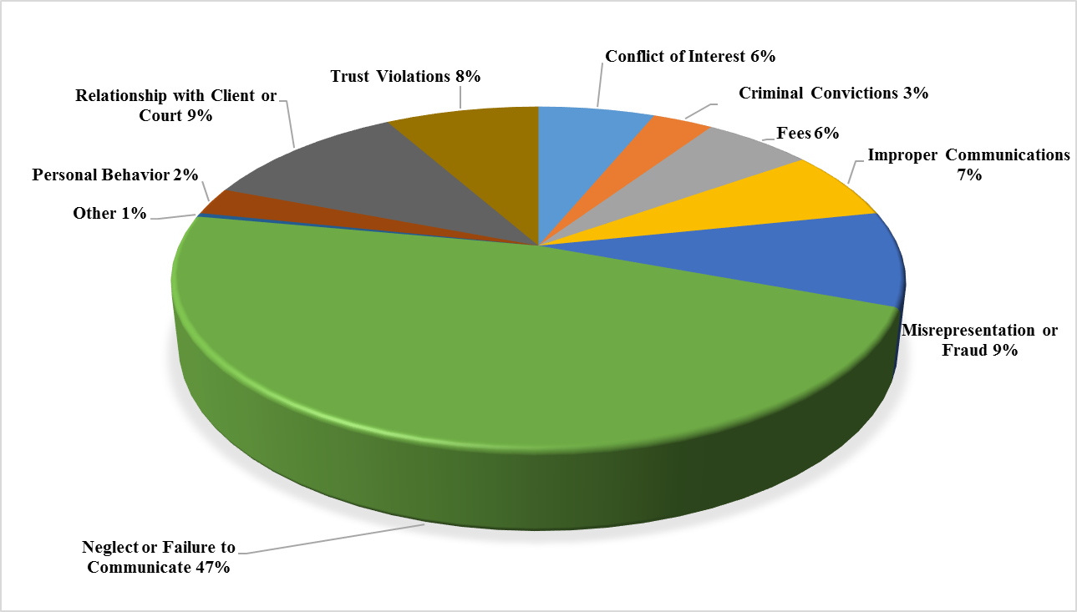
Nature of Complaints

Slide 4
RPC 1.1
COMPETENCE
A lawyer shall provide competent representation to a client. Competent representation requires the legal knowledge, skill, thoroughness, and preparation reasonably necessary for the representation.

Slide 5
RPC 1.1 Comment [8]
To maintain the requisite knowledge and skill, a lawyer should keep abreast of changes in the law and its practice, including the benefits and risks associated with relevant technology, engage in continuing study and education, and comply with all continuing legal education requirements to which the lawyer is subject.

Slide 6
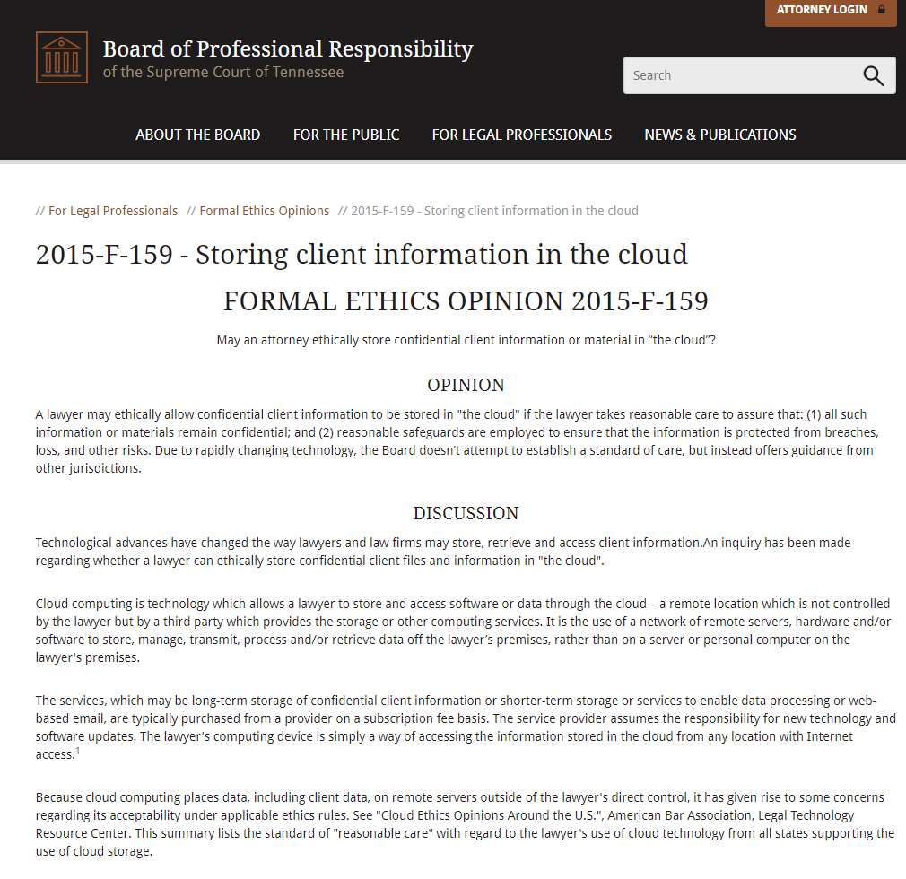
Tennessee Formal Ethics Opinion 2015-F-159(2015)

Slide 7
What could go wrong with communicating with clients by text?

Slide 8
Problem #1 Confidentiality You send the text to the wrong person.

Slide 9
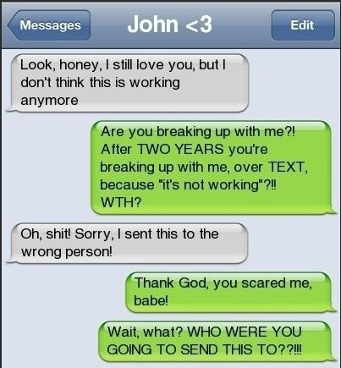

Slide 10
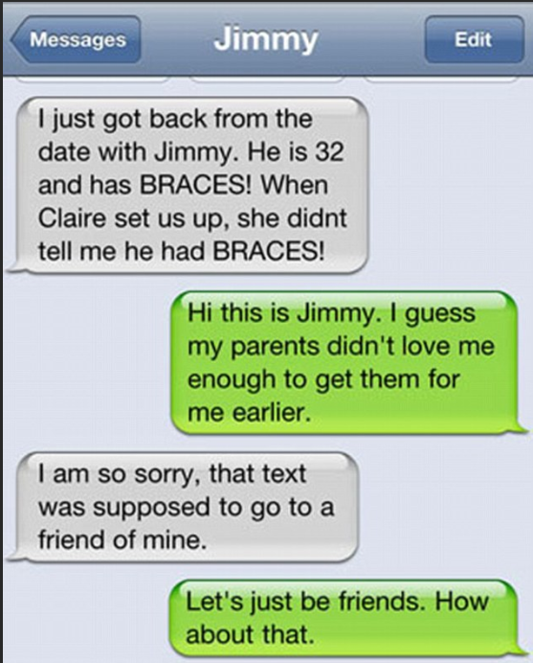

Slide 11
CONFIDENTIALITY OF INFORMATION
RPC 1.6
the client gives informed consent;
the disclosure is impliedly authorized in order to carry out the representation; or
the disclosure is permitted by paragraph (b) or required by paragraph (c).
1
2
3
(a) A lawyer shall not reveal information relating to the representation of a client unless:

Slide 12
RPC 4.4(b) Respect for the Rights of Third Person
A lawyer who receives information relating to the representation of the lawyer’s client that the lawyer knows or reasonably should know is protected by RPC 1.6 (including information protected by the attorney-client privilege or the work-product rule) and has been disclosed to the lawyer inadvertently or by a person not authorized to disclose such information to the lawyer, shall:
Immediately terminate review of the information;
Notify the person, or the person’s lawyer if communication with the person is prohibited by RPC 4.2, of the inadvertent or disclosure; and
Abide by that person’s or lawyer’s instructions with respect disposition of written information or refrain from using information until obtaining a definitive ruling on the proper disposition from a court with appropriate jurisdiction.

Slide 13
Problem #2 Delay

Slide 14
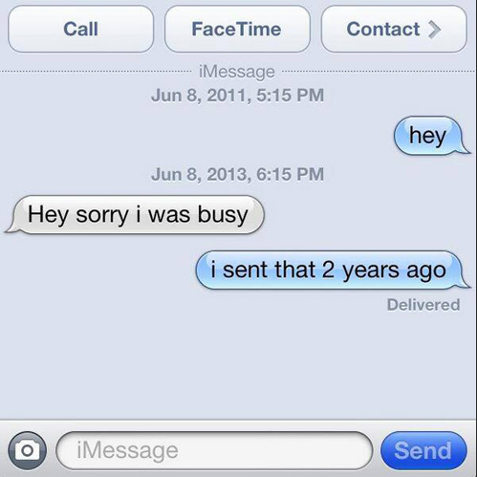

Slide 15
Problem #3 Professionalism

Slide 16
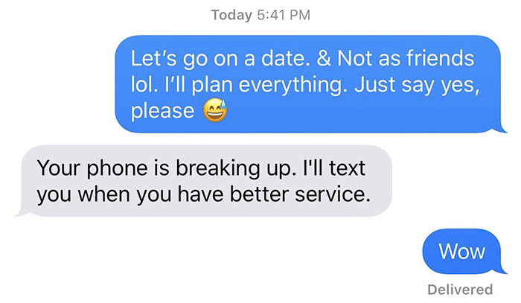
Problem #4 Conflicts

Slide 17
RPC 1.7(a)(2)
CONFLICT OF INTEREST: CURRENT CLIENTS
(a) Except as provided in paragraph (b), a lawyer shall not represent a client if the representation involves a concurrent conflict of interest. A concurrent conflict of interest exists if:
2) There is a significant risk that the representation of one or more clients will be materially limited by the lawyer’s responsibilities to another client, former client or a third client or by a personal interest of the lawyer.

Slide 19
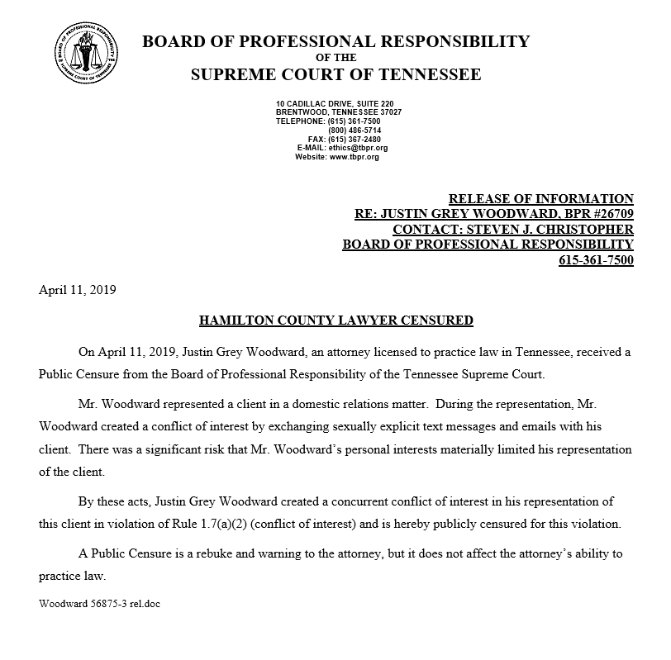

Slide 20
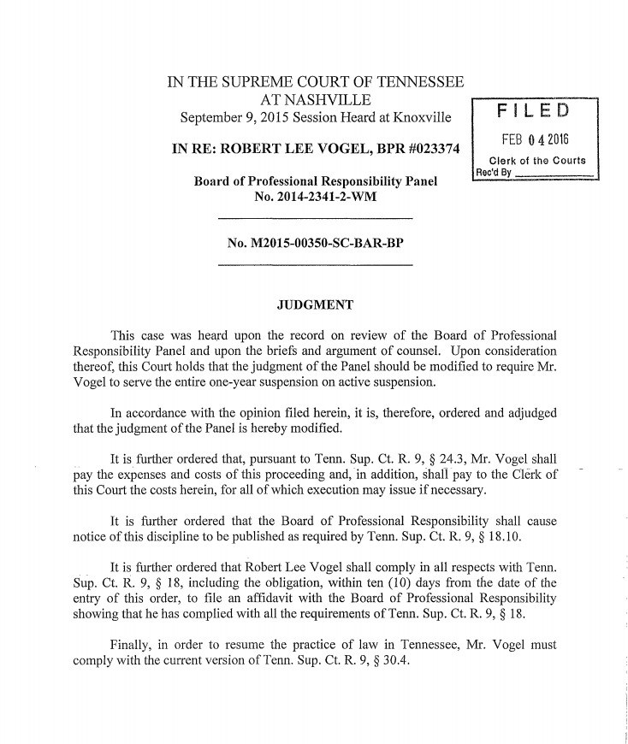
In re Vogel, 482 S.W. 3d 520, 522 (Tenn. 2016)

Slide 21
Disciplinary Counsel v. Bartels, 151 Ohio St. 3d 144 (2016)

Slide 22
Disciplinary Proceedings against Kratz, 353 Wis.2d 696 (2014)

Slide 23
Disciplinary Matter Involving Stanton, 376 P.3d 693 (Alaska 2016)

Slide 24
Problem #5 File Retention

Slide 25
Tennessee Formal Ethics Opinion 2015-F-160 (2015)
Tennessee Formal Ethics Opinion 2015-F-160(a)(2015)

Slide 26
Rule No. 1: Don’t say or write anything that you don’t want broadcast to the world!​
Rule No. 2: Electronic communication can be great, but immediate communication absent thought is stupid!​

Slide 27
Two options:​
1. No messaging/texting with clients, counsel, court staff, witnesses, etc about a client matter​
2. Texting, but preserve the texts for the file​
REMEMBER: Don’t write anything you wouldn’t want to see as an exhibit in court (or broadcast to the world)

Slide 28
How do I do this? 1. Screenshots/printing from your phone 2. Phone Apps / Text Archiving Apps (like iExplorer) 3. Windows 10: Your Phone Companion 4. MacOS: iMessage (with text message forwarding turned on)

Slide 29
Phone Apps / Text Archiving Apps
“How to save text messages in Android and iOS”
By Simon Hill, Digital Trends, June 18, 2018
https://www.digitaltrends.com/mobile/how-to-save-text-messages/

Slide 30
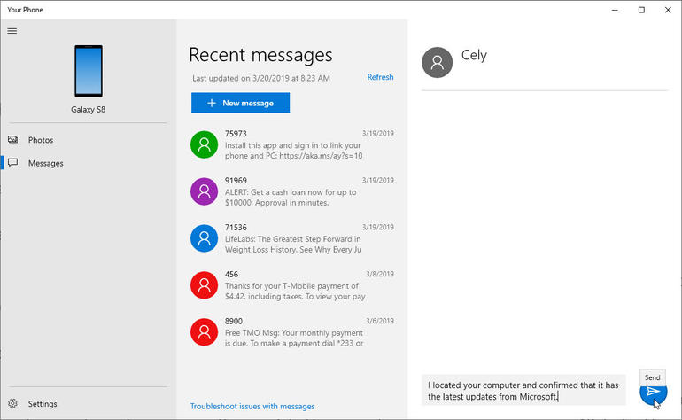
Windows 10: Your Phone Companion
“How to Access your Android phone’s texts and photos in Windows 10” by Lance Whitney, TechRepublic, March 20, 2019
https://www.techrepublic.com/article/how-to-access-your-android-phones-texts-and-photos-in-windows-10/

Slide 31
MacOs
“Use Messages with your Mac”
Apple Support, Sept. 24, 2018
https://support.apple.com/en-us/HT202549
“How to forward text messages on your iPhone”
Apple Support, March 12, 2019
https://support.apple.com/en-us/HT208386
“Keep all your messages in iCloud”
Apple Support, April 2, 2019
https://support.apple.com/en-us/HT208532

Slide 32
Text messages:​
-copying from client’s phone​
-exporting to PDF​
-preserving messages for your file​
​

Slide 33
Thank you

